Slide 1
COMP3028 Software Architecture

Slide 2
Review

Slide 3
Architecture and Requirements
System requirements can be categorized as:
Functional requirements state what the system must do, how it must behave or react to run-time stimuli.
Quality attribute requirements qualify functional requirements, e.g., how fast the function must be performed, how resilient it must be to erroneous input, etc.
Constraints. A constraint is a design decision with zero degrees of freedom.

Slide 4
Quality Attribute Considerations - example
Functional requirement
"when the user presses the green button the Options dialog appears”:
Quality of this function
a performance qualification might describe how quickly the dialog will appear;
an availability qualification might describe how often this function will fail, and how quickly it will be repaired;
a usability qualification might describe how easy it is to learn this function.

Slide 5
Two Categories of Quality Attributes
The ones that describe some properties of the system at runtime
Availability
The ones that describe some properties of the development of system
Modifiability
Testability
Performance
Usability
Security

Slide 6
Quality Attribute Considerations
There are problems with previous discussions of quality attributes:
Untestable definitions. The definitions provided for an attribute are not testable. It is meaningless to say that a system will be “modifiable”
Overlapping concerns. Is a system failure due to a denial of service attack an aspect of availability, performance, security, or usability?

Slide 7
Specifying Quality Attribute Requirements
Stimulus
The stimulus is a condition that requires a response when it arrives at a system.
Source of stimulus
This is some entity (a human, a computer system, or any other actuator) that generated the stimulus.
Response
The response is the activity undertaken as the result of the arrival of the stimulus.
Response measure
When the response occurs, it should be measurable in some fashion so that the requirement can be tested.
Environment
The stimulus occurs under certain conditions. The system may be in an overload condition or in normal operation, or some other relevant state.
Artifact
This may be a collection of systems, the whole system, or some piece or pieces of it. Some artifact is stimulated.

Slide 8
Specifying Quality Attribute Requirements
General quality attribute scenarios are system independent and can, potentially, pertain to any system
Concrete quality attribute scenarios are specific to the particular system under consideration.

Slide 9
Achieving Quality Attributes Through Tactics
Tactics
Architectural design primitives that an architect can use to achieve a quality attribute response
We do not invent tactics, we simply capture what architects do in practice

Slide 10
Availability General Scenario
Portion of Scenario | Possible Values
Source | Internal/external: people, hardware, software, physical infrastructure, physical environment
Stimulus | Fault: omission, crash, incorrect timing, incorrect response
Artifact | System’s processors, communication channels, persistent storage, processes
Environment | Normal operation, startup, shutdown, repair mode, degraded operation, overloaded operation
Response | Prevent the fault from becoming a failure Detect the fault: log the fault notify appropriate entities (people or systems) Recover from the fault disable source of events causing the fault be temporarily unavailable while repair is being effected fix or mask the fault/failure or contain the damage it causes operate in a degraded mode while repair is being effected
Response Measure | Time or time interval when the system must be available Availability percentage (e.g. 99.999%) Time to detect the fault Time to repair the fault Time or time interval in which system can be in degraded mode Proportion (e.g., 99%) or rate (e.g., up to 100 per second) of a certain class of faults that the system prevents, or handles without failing

Slide 11
Sample Concrete Availability Scenario
The heartbeat monitor determines that the server is nonresponsive during normal operations. The system informs the operator and continues to operate with no downtime.

Slide 12
Availability Tactics

Slide 13
Interoperability General Scenario
Portion of Scenario | Possible Values
Source | A system
Stimulus | A request to exchange information among system(s).
Artifact | The systems that wish to interoperate
Environment | System(s) wishing to interoperate are discovered at run time or known prior to run time.
Response | One or more of the following: the request is (appropriately) rejected and appropriate entities (people or systems) are notified the request is (appropriately) accepted and information is exchanged successfully the request is logged by one or more of the involved systems
Response Measure | One or more of the following: percentage of information exchanges correctly processed percentage of information exchanges rejected

Slide 14
Sample Concrete Interoperability Scenario
Our vehicle information system sends our current location to the traffic monitoring system.
The traffic monitoring system combines our location with other information, overlays this information on a Google Map, and broadcasts it.
Our location information is correctly included with a probability of 99.9%.

Slide 15
Interoperability Tactics

Slide 16
Software Architecture
Quality attributes: Modifiability

Slide 17
Intended Learning Outcomes
By the end of this lesson you will be able to:
apply the design decision categories to modifiability

Slide 18
What is Modifiability?
Modifiability is about change and our interest in it is in the cost and risk of making changes.

Slide 19
What is Modifiability?
Modifiability is about change and our interest in it is in the cost and risk of making changes.
To plan for modifiability, an architect has to consider four questions:
What can change?
What is the likelihood of the change?
When is the change made and who makes it?
What is the cost of the change?

Slide 20
 | the cost of introducing the mechanisms to make the system more modifiable | the cost making the modification using the mechanism
do nothing for now | zero | The cost of changing the source code and revalidating the system
add additional component to the system now – user interface builder | The cost of constructing the UI builder, it can be substantial | The cost of producing the input to feed the builder – substantial or negligible The cost of running the builder – negligible The cost of the testing that is needed on the new interface– usually much less than usual

Slide 21
Modifiability General Scenario
Portion of Scenario | Possible Values
Source | End user, developer, system administrator
Stimulus | A directive to add/delete/modify functionality, or change a quality attribute, capacity, or technology
Artifacts | Code, data, interfaces, components, resources, configurations, …
Environment | Runtime, compile time, build time, initiation time, design time
Response | One or more of the following: make modification test modification deploy modification
Response Measure | Cost in terms of: number, size, complexity of affected artifacts effort calendar time money (direct outlay or opportunity cost) extent to which this modification affects other functions or quality attributes new defects introduced

Slide 22
Sample Concrete Modifiability Scenario
The developer wishes to change the user interface by modifying the code at design time. The modifications are made with no side effects within three hours.
Stimulus – Wishes to change UI
Artifact – Code
Environment: Design time
Response – Change made
Response measure – No side effects in three hours
Source - Developer

Slide 23
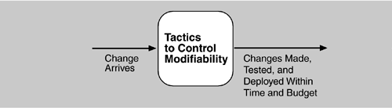
Goal of Modifiability Tactics
Goal of modifiability
controlling the complexity of making changes,
controlling the time and cost to make changes.

Slide 24
Modifiability Tactics

Slide 25
Reduce Size of a Module
Split Module: If the module being modified includes a great deal of capability, the modification costs will likely be high.
Refining the module into several smaller modules should reduce the average cost of future changes.

Slide 26
Increase Cohesion
Increase Semantic Coherence: If the responsibilities A and B in a module do not serve the same purpose, they should be placed in different modules.
This may involve creating a new module or it may involve moving a responsibility to an existing module.

Slide 27
Reducing Coupling
What is coupling?
If two modules’ responsibilities overlap, a single change may affect them both
Coupling is measured by this overlap, i.e., by the probability that a modification to one module will propagate to the other
High coupling is an enemy of modifiability

Slide 28
Reduce Coupling
Encapsulate: Encapsulation introduces an explicit interface to a module. This interface includes an API and its associated responsibilities
Use an Intermediary: Given a dependency between responsibility A and responsibility B (for example, carrying out A first requires carrying out B), the dependency can be broken by using an intermediary.

Slide 29
Publish/Subscribe System

Slide 30
Introduction: Motivations for Pub/Sub model
Traditional Client/Server communication model
(Employs RPC, message queue etc..)
Synchronous, tightly-coupled request invocations.
Very restrictive for distributed applications, especially for WAN and mobile environments.
When nodes/links fail, system is affected. Fault Tolerance must be built in to support this.
Require a more flexible and de-coupled communication style that offers asynchronous mechanisms.

Slide 31
What is a Publish/Subscribe System?
Pub/Sub System is a communication paradigm that allows freedom in the (distributed) system by the decoupling of communication entities in terms of time, space and synchronization.
An event service system that is asynchronous, anonymous and loosely-coupled.
Ability to quickly adapt in a dynamic environment.

Slide 32
Key components of Pub/Sub System
Publishers : Publishers generate event data and publishes them.
Subscribers : Subscribers submit their subscriptions and process the events received
P/S service: It’s the mediator/broker that filters and routes events from publishers to interested subscribers.

Slide 33
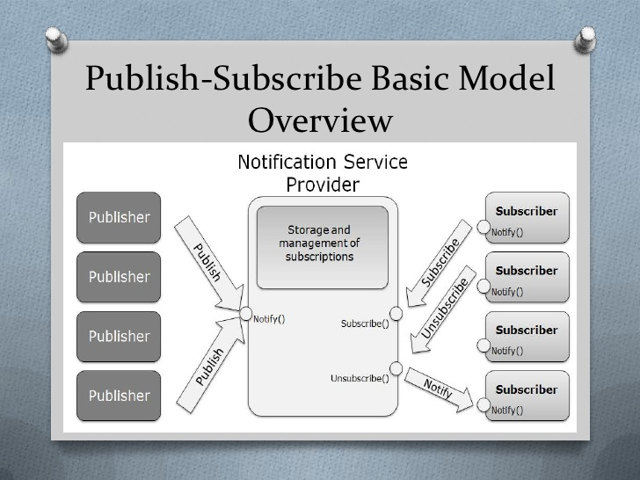
Publish/Subscribe System

Slide 34
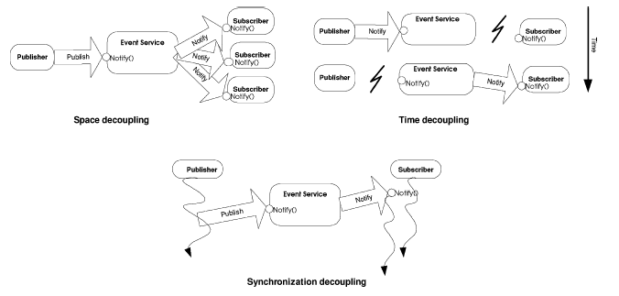
Decoupling in time, space and synchronization
Provides decoupling in time, space and synchronization.

Slide 35
Classification of Pub/Sub Architectures
Centralized Broker model
Consists of multiple publishers and multiple subscribers and centralized broker/brokers (an overlay network of brokers interacting with each other).
Subscribers/Publishers will contact 1 broker, and do not need to have knowledge about others.
E.g. CORBA event services, JMS, JEDI etc…

Slide 36
Classification of Pub/Sub Architectures
Peer-to-Peer model
Each node can be publisher, subscriber or broker.
Subscribers subscribe to publishers directly and publishers notify subscribers directly. Therefore they must maintain knowledge of each other.
Complex in nature, mechanisms such as DHT and CHORD are employed to locate nodes in the network.
E.g. Java distributed event service

Slide 37
Key Functions Implemented by P/S Middleware Service
Event filtering (event selection)
The process of selecting the set of subscribers that have shown interest in a given event.
Subscriptions are stored in memory and searched when a publisher publishes a new event.
Event routing (event delivery)
The process of routing the published events to all interested subscribers

Slide 38
Event Filtering (Subscription Model) Topic based VS Content based
Topic based
Generally also known as topic based, group based or channel based event filtering.
Each event is published to one of these channels by its publisher.
Subscribers subscribes to a particular channel and will receive ALL events published to the subscribed channel.

Slide 39
Topic-based subscription
Simple process for matching an event to subscriptions. However, limited expressiveness.
Event filtering is easy, event routing is difficult (Heavy load on the network). The challenge is to multicast event effectively to subscribers.

Slide 40
Event Filtering- Subscription Model Topic based VS Content based
Content based
More flexibility and power to subscribers, by allowing more expression in arbitrary/customized query over the contents of the event.
Event publication by a key/value attribute pair, and subscriptions specify filters using a explicit subscription language.
E.g. Notify me of all stock quotes of IBM from New York stock exchange if the price is greater than 150

Slide 41
Content-based Subscription
Added complexity in matching an event to subscriptions.
However, more precision is provided and event routing is easier

Slide 42
Advantages of Pub/Sub
Highly suited for mobile applications, ubiquitous computing and distributed embedded systems
Robust – Failure of publishers or subscribers does not bring down the entire system
Scalability- Suited to build distributed applications consisting a large number of entities
Adaptability- can be varied to suit different environments (mobile, internet game, embedded systems etc…)

Slide 43
Disadvantages of Pub/Sub
Reliability – no strong guarantee on broker to deliver content to subscriber. After a publisher publishes the event, it assumes that all corresponding subscribers would receive it.
Potential bottleneck in brokers when subscribers and publishers overload them. (Solve by load balancing techniques)

Slide 44
Modifiability Tactics

Slide 45
Reduce Coupling
Restrict Dependencies: restricts the modules which a given module interacts with or depends on.
By restricting a module’s visibility and by authorization
For example,
a layer is allowed to see the modules in its bottom layer

Slide 46
Reduce Coupling
Abstract Common Services: where two modules provide not-quite-the-same but similar services, it may be cost-effective to implement the services just once in a more general (abstract) form.

Slide 47
Summary
Modifiability deals with change and the cost in time or money of making a change, including the extent to which this modification affects other functions or quality attributes.
Tactics to reduce the cost of making a change include making modules smaller, increasing cohesion, and reducing coupling.

